Slide 1
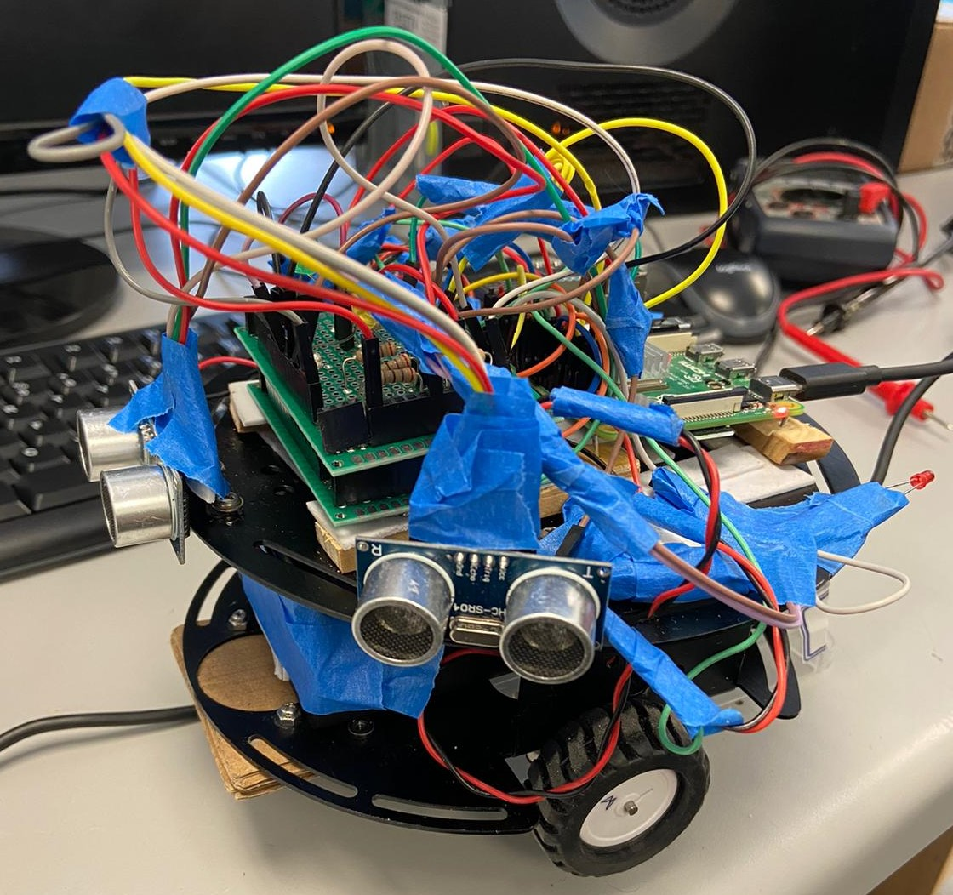
Smart Vehicle System
Team Green
-Tayeb
-Rohan
-Bhargav

Slide 2
Project Description
Vehicle will detect obstacles and can avoids obstacle by changing its direction.
It will balance itself on the straight path with the help of encoder technology.
It will control its speed

Slide 3
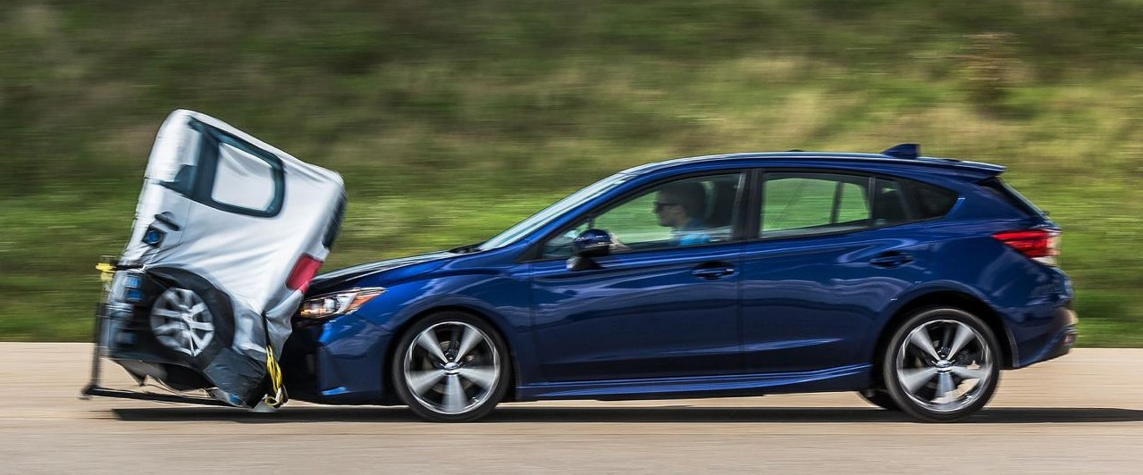
Problem Statement
While driving it happens often that any vehicle or obstacle come in way unexpectedly, which can cause life threatening accident.
Designed a system that can keeps driver and car both safe.

Slide 4
Project Requirement
Designing a system for car that will keep its safe distance from an object
Avoid any obstacles either by turning right or left depending on the situation.

Slide 5
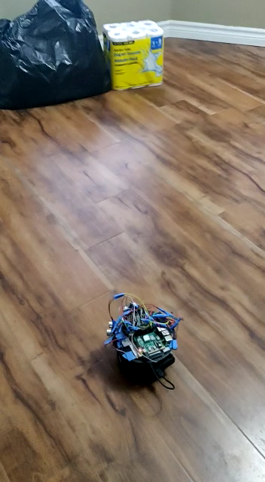
Result

Slide 6
Concluding Statement
Things we might add:
Maintaining its speed depending on vehicle in front.
Returns to same path.
Capture obstacle information from front, left and right of vehicle.
Future scope:
GPS Technology.
Computer Vision.
Special Thanks:
-Ralph Stacey
-Justin To

Slide 7
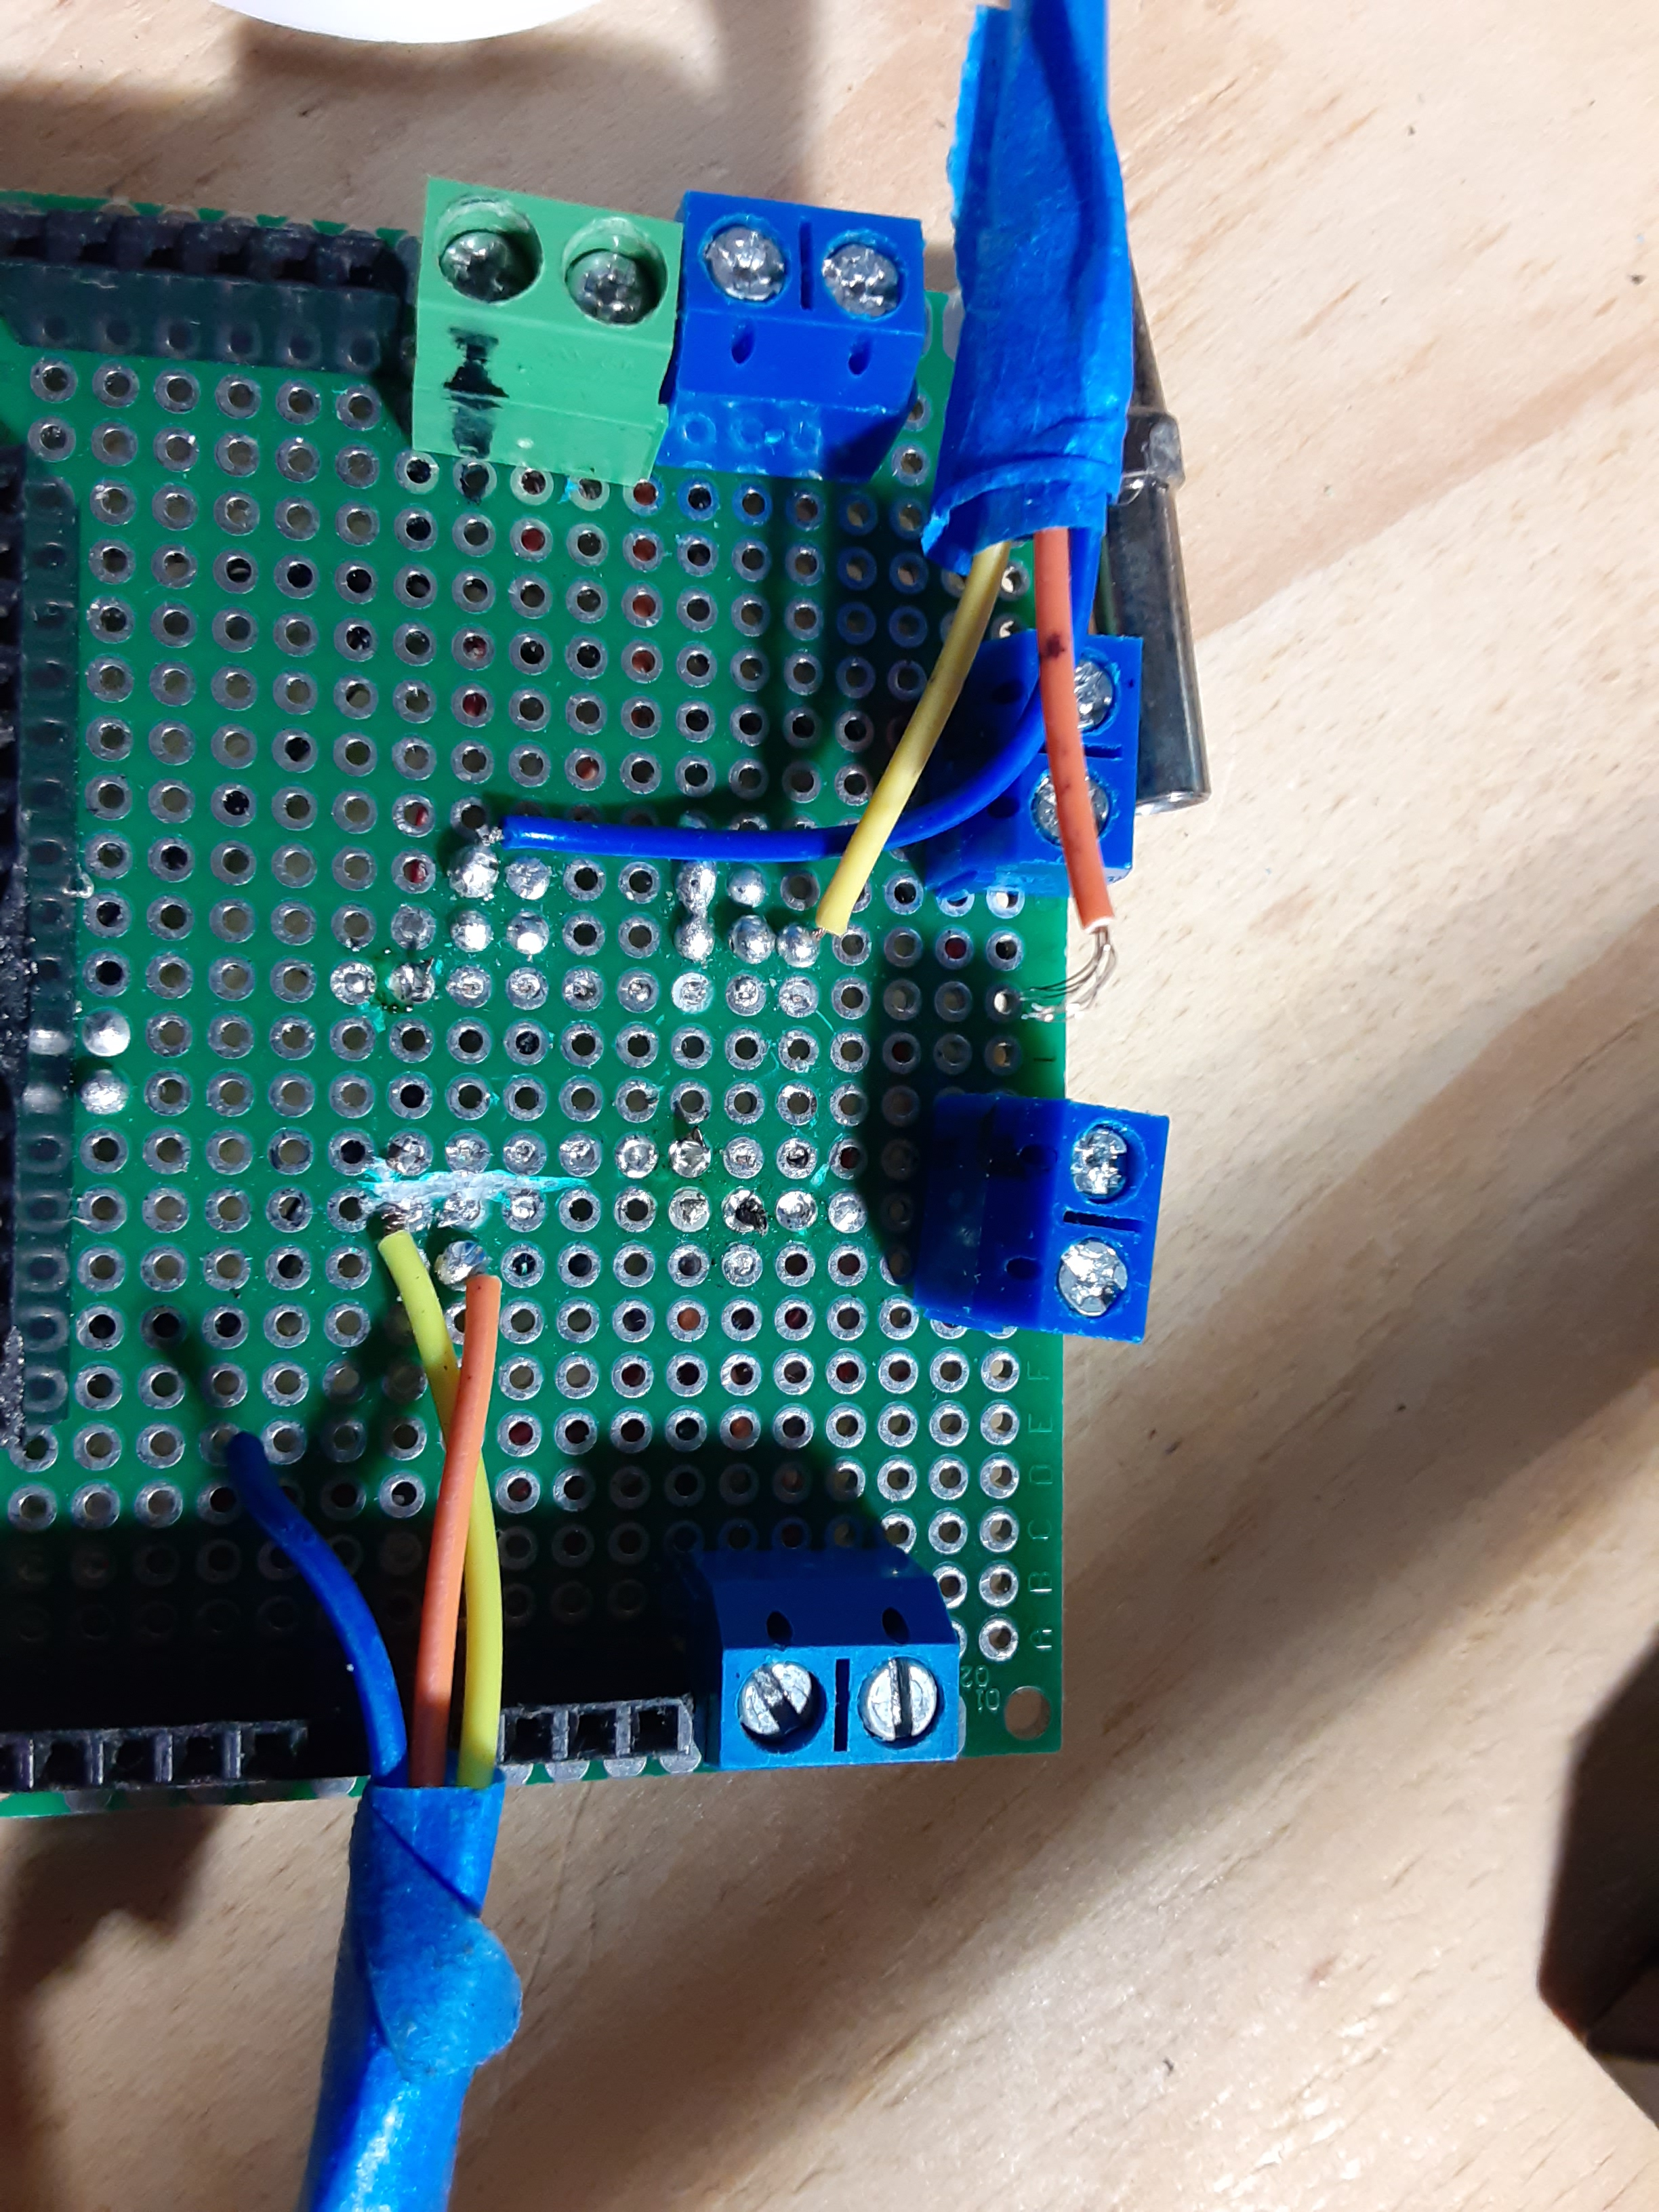
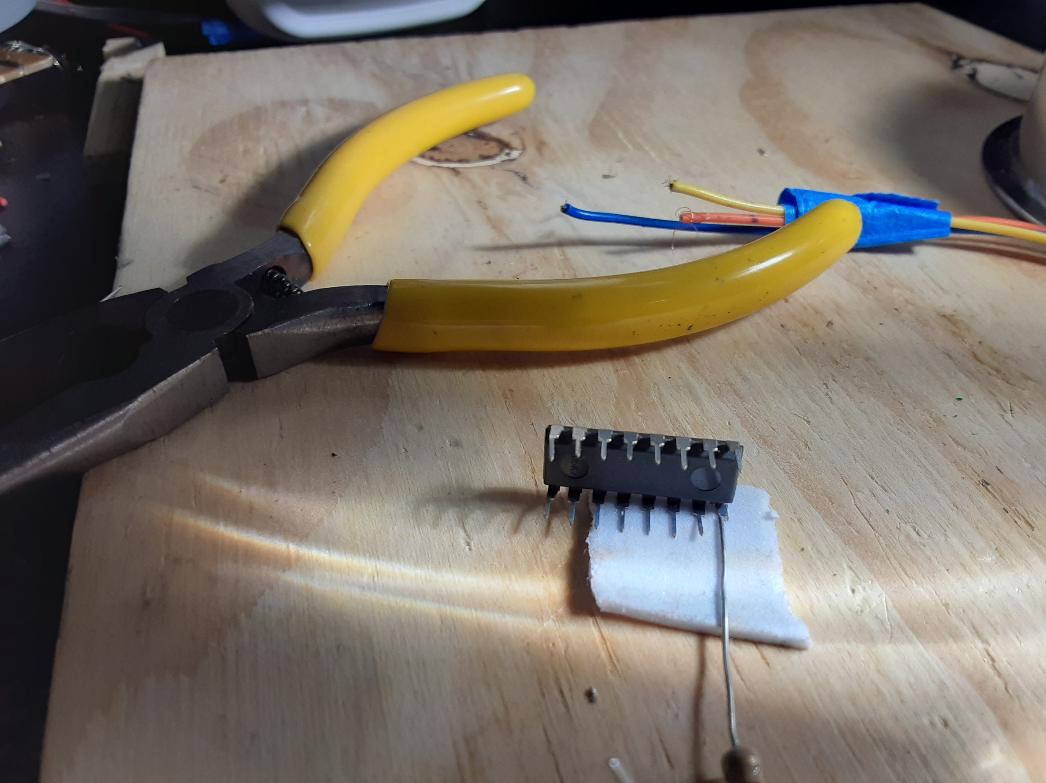
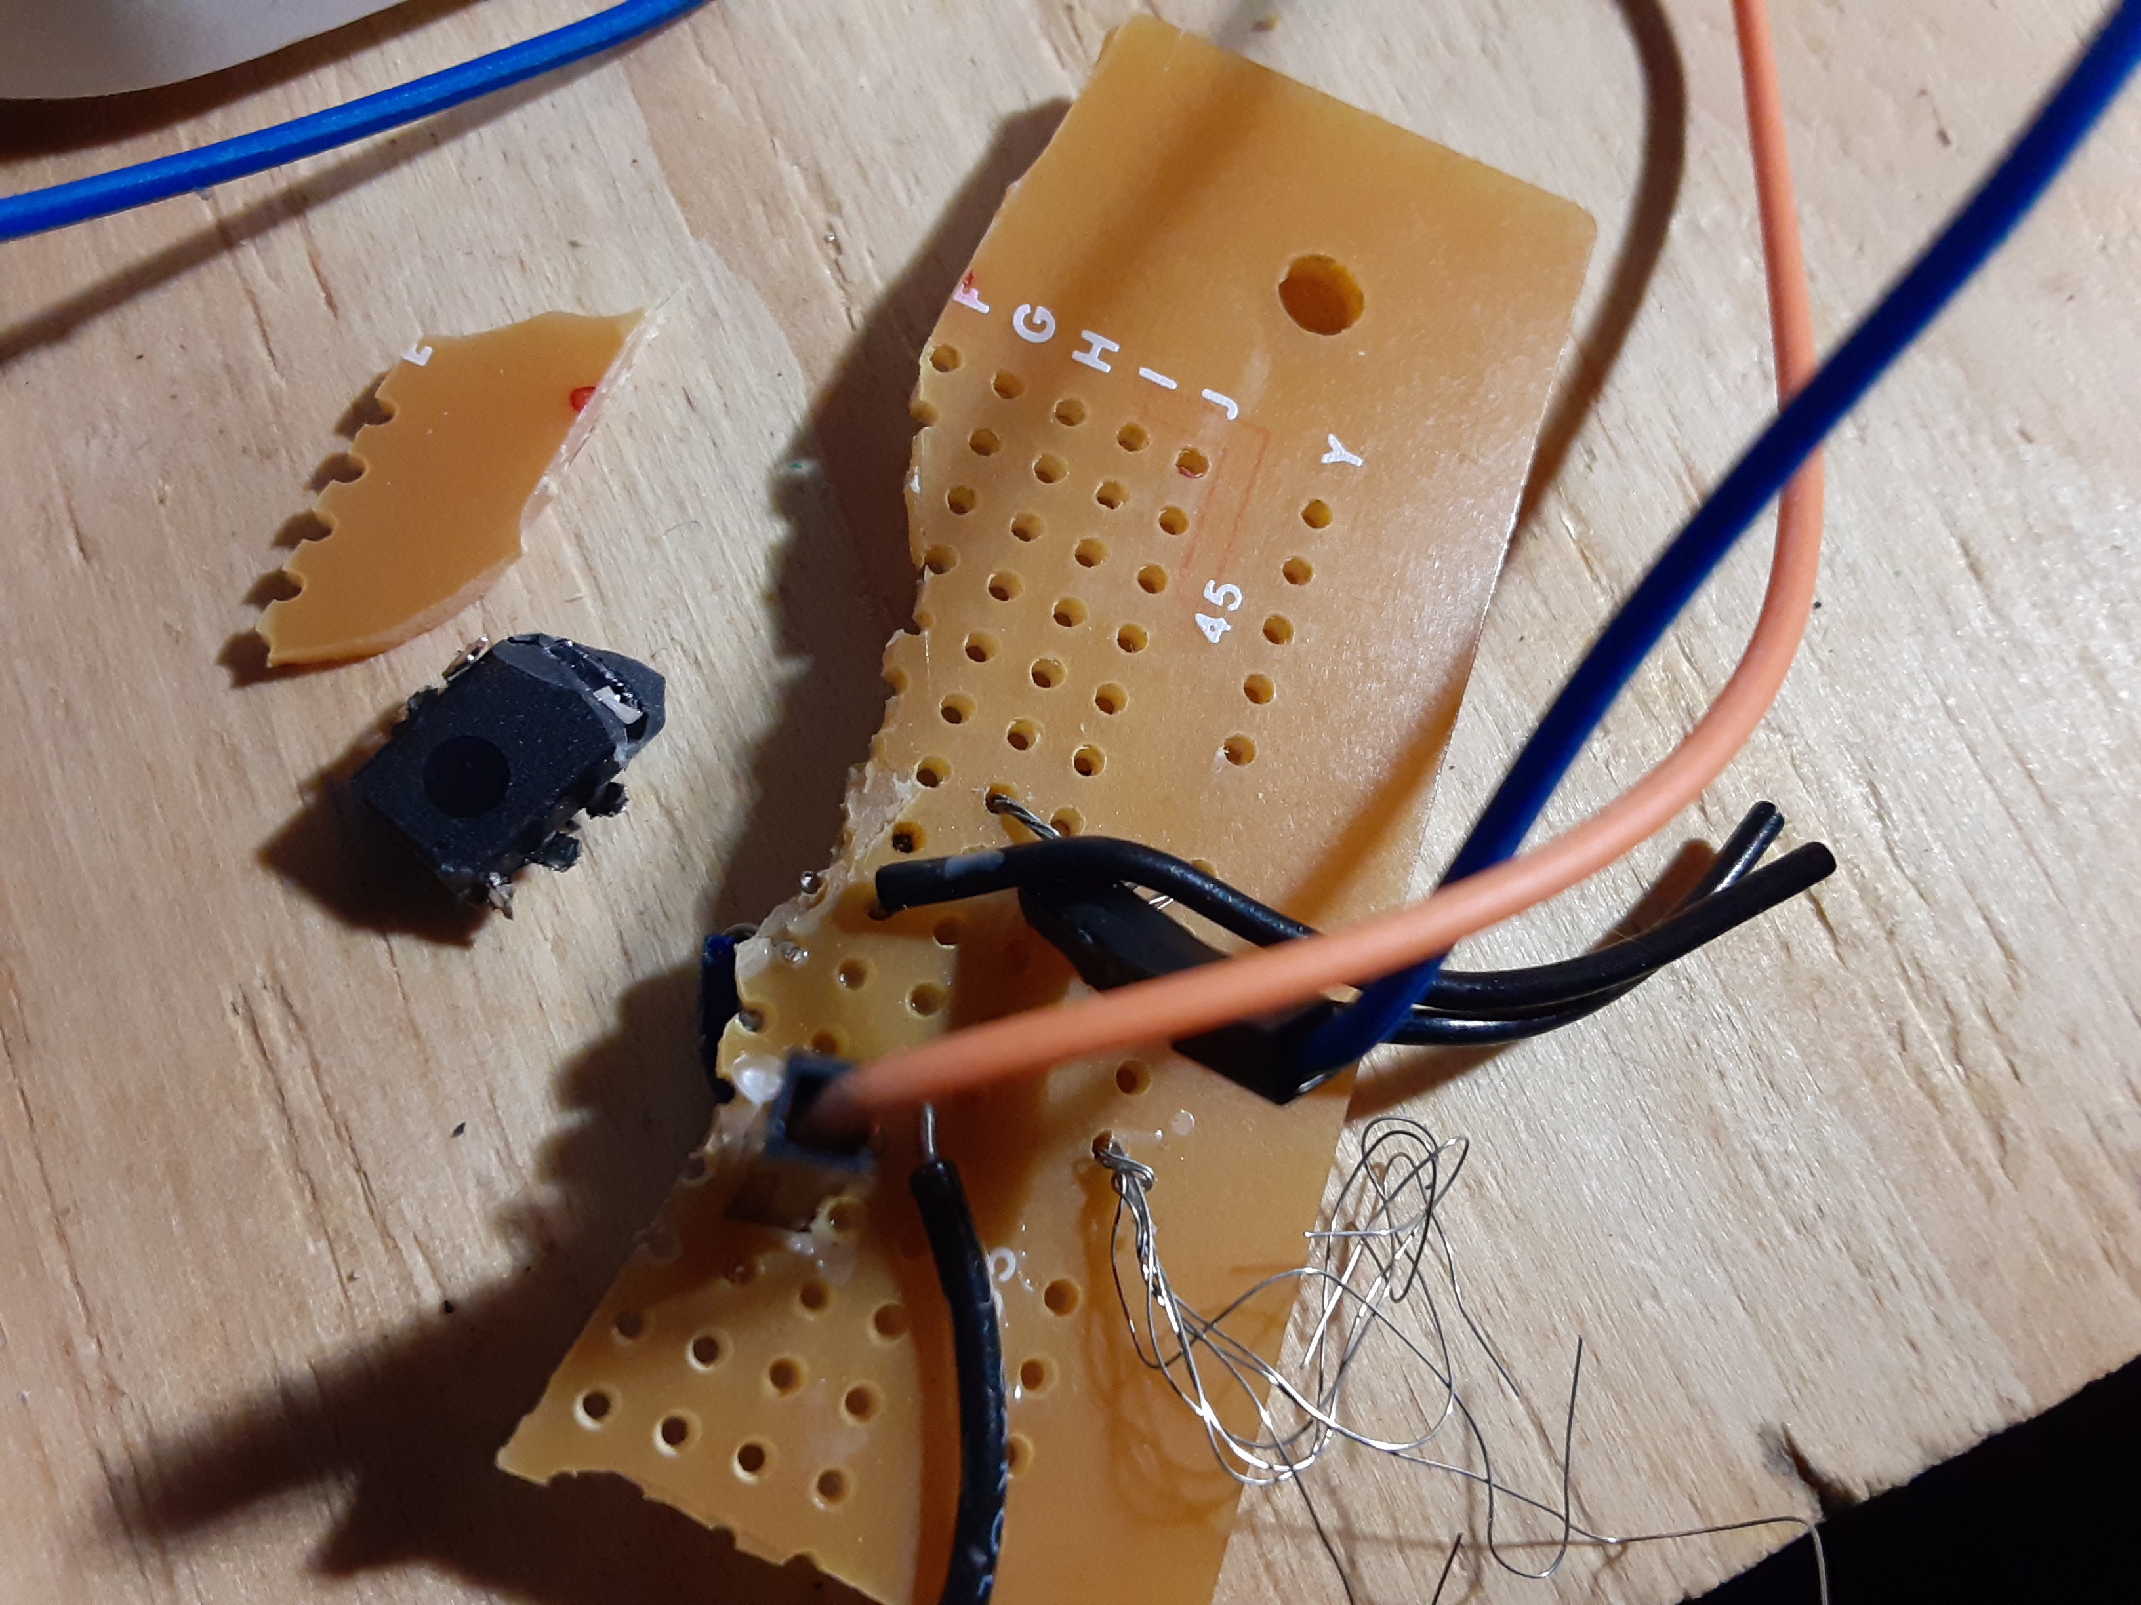
Problems we Faced

Slide 8
Thankyou

